Slide 1
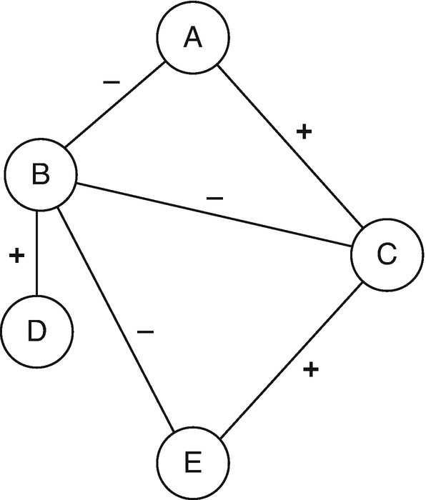
Valenced interactions
Most social network theories assume ties and network flows are usually positive or neutral:
  Ties
    Friendship
    Kinship
    Co-membership
  Flows
    Information
    Support
    Gossip
    Violence

Slide 2
Valenced interactions
Most real-world social networks feature a mix of:
  Positive and negative ties:
    Friends and enemies
    Liking and disliking
    Members of same group versus rival groups
  Positive and negative flows:
    Gossip versus compliments
    Helping versus violence
These are called valenced relationships

Slide 3
Valenced interactions
Core network concepts change meaning when ties are valenced!
  In-degree centrality:
    Friendship (good)
    Disliking (bad!)
    Support (good!)
    Enemies (bad?)
  The same goes for out-degree:
    A bully is a person who has lots of outgoing negative ties
  And other network metrics:
    Closeness, Betweenness, Eigenvector

Slide 4
Valenced interactions
We have seen on network theory (balance) designed to explain valenced relationships
But this is not the only approach!
  Status theory
    (an extension of balance theory)
  Karma Theory
    Rich get richer effect
  Solidarity Theory
    Homophily based on positive and negative interactions

Slide 5
Status Theory

Slide 6
Valenced interactions: Status theory
Ego
Other
Neg.
Pos.
Status Theory
  Designed to explain distribution of positive and negative ties in valenced networks with directed ties
First principle:
  Status in valenced networks is determined by sign of ties received
    High status
      Lots of incoming positive ties
    Low status
      Lots of incoming negative ties
    Directed positive tie from i →j:
      I thinks of j as higher status
High Status
Low Status

Slide 7
Valenced interactions: Status theory
Ego
Other
Neg.
Pos.
Status Theory
  Designed to explain distribution of positive and negative ties in valenced networks with directed ties
First principle:
  Status in valenced networks is determined by sign of ties received
    High status
      Lots of incoming positive ties
    Low status
      Lots of incoming negative ties
    Directed negative tie from i →j:
      I thinks of j as lower status
High Status
Low Status

Slide 8
Valenced interactions: Status theory
Ego
Other
Neg.
Pos.
Status Theory
  Designed to explain distribution of positive and negative ties in valenced networks with directed ties
Second principle:
  Status of nodes is also determined by the sign of their connections to (high and low status) others
    Positive ties to high status others increase status
    Positive ties to low status others decrease status
Status Boost
Status Loss

Slide 9
Valenced interactions: Status theory
Ego
Other
Neg.
Pos.
Status Theory
  Designed to explain distribution of positive and negative ties in valenced networks with directed ties
Second principle:
  Status of nodes is also determined by the sign of their connections to (high and low status) others
    Positive ties to high status others increase status
    Positive ties to low status others decrease status
Status Boost
Status Loss

Slide 10
Valenced interactions: Status theory
Ego
Other
Neg.
Pos.
Status Theory
  Designed to explain distribution of positive and negative ties in valenced networks with directed ties
Second principle:
  Status of nodes is also determined by the sign of their connections to (high and low status) others
    Negative ties to high status others decrease status
    Negative ties to low status others increase status
Status Loss
Status Boost

Slide 11
Valenced interactions: Status theory
Ego
Other
Neg.
Pos.
Status Theory
  Designed to explain distribution of positive and negative ties in valenced networks with directed ties
Second principle:
  Status of nodes is also determined by the sign of their connections to (high and low status) others
    Negative ties to high status others decrease status
    Negative ties to low status others increase status
Status Loss
Status Boost

Slide 12
Valenced interactions: Status theory
Ego
Other
Neg.
Pos.
Status Theory
  Designed to explain distribution of positive and negative ties in valenced networks with directed ties
Third principle:
  People aim to avoid status loss and seek status boosts:
    High status individuals will accumulate positive ties
      Rich get richer effect
Time 1
Time 2

Slide 13
Valenced interactions: Status theory
Ego
Other
Neg.
Pos.
Status Theory
  Designed to explain distribution of positive and negative ties in valenced networks with directed ties
Third principle:
  People aim to avoid status loss and seek status boosts:
    Low status individuals will accumulate negative ties
      “Gang up” effect (Poor get poorer)
Time 1
Time 2

Slide 14
Valenced interactions: Status theory
Ego
Other
Neg.
Pos.
Status Theory
  Designed to explain distribution of positive and negative ties in valenced networks with directed ties
Third principle:
  People aim to avoid status loss and seek status boosts:
    High status individuals will lose negative ties
Time 1
Time 2

Slide 15
Valenced interactions: Status theory
Ego
Other
Neg.
Pos.
Status Theory
  Designed to explain distribution of positive and negative ties in valenced networks with directed ties
Third principle:
  People aim to avoid status loss and seek status boosts:
    Low status individuals will lose positive ties
Time 1
Time 2

Slide 16
Karma Theory

Slide 17
Valenced interactions: Karma theory
Ego
Other
Neg.
Pos.
Karma Theory: You get what you spread out!
  Status theory is based on (negative and positive) popularity
    Graph-theoretic indegree centrality
  Karma theory is based on (negative and positive) activity
    Graph theoretic outdegree centrality
Time 1
Time 2

Slide 18
Valenced interactions: Karma theory
Ego
Other
Neg.
Pos.
Karma Theory: You get what you spread out!
  Status theory is based on (negative and positive) popularity
    Graph theoretic indegree centrality
  Karma theory is based on (negative and positive) activity
    Predict valenced indegree (what you get) from valenced outdegree (what you spread)
Time 1
Time 2

Slide 19
Valenced interactions: Karma theory
Ego
Other
Neg.
Pos.
Karma Theory: You get what you spread out!
  Status theory is based on (negative and positive) popularity
    Graph theoretic indegree centrality
  Karma theory is based on (negative and positive) activity
    Predict valenced indegree (what you get) from valenced outdegree (what you spread)
Bullies get bullied!
Time 2
Time 1

Slide 20
Valenced interactions: Karma theory
Ego
Other
Neg.
Pos.
Karma Theory: You get what you spread out!
  Status theory is based on (negative and positive) popularity
    Graph theoretic indegree centrality
  Karma theory is based on (negative and positive) activity
    Predict valenced indegree (what you get) from valenced outdegree (what you spread)
Likers get liked!
Time 2
Time 1

Slide 21
Solidarity Theory

Slide 22
Valenced interactions: Solidarity theory
Ego
Other
Neg.
Pos.
Solidarity Theory
  People in the same position in the valenced interaction network link via positive ties
Two types of solidarity:
  Status solidarity
  Karma solidarity
Time 1
Time 2

Slide 23
Valenced interactions: Solidarity theory
Ego
Other
Neg.
Pos.
Solidarity Theory
  People in the same position in the valenced interaction network link via positive ties
Two types of solidarity:
  Status solidarity
  Karma solidarity
Popular “in-crowd” effect
Time 2
Time 1

Slide 24
Valenced interactions: Solidarity theory
Ego
Other
Neg.
Pos.
Solidarity Theory
  People in the same position in the valenced interaction network are likely to link via positive ties
Two types of solidarity:
  Status solidarity
  Karma solidarity
The downtrodden stick together!
Time 2
Time 1

Slide 25
Valenced interactions: Solidarity theory
Ego
Other
Neg.
Pos.
Solidarity Theory
  People in the same position in the valenced interaction network are likely to link via positive ties
Two types of solidarity:
  Status solidarity
  Karma solidarity
Bullies stick together!
Time 2
Time 1

Slide 26
Valenced interactions: Solidarity theory
Ego
Other
Neg.
Pos.
Solidarity Theory
  People in the same position in the valenced interaction network are likely to link via positive ties
Two types of solidarity:
  Status solidarity
  Karma solidarity
Cool kids stick together!
Time 2
Time 1

Slide 27
Dominance Hierarchies

Slide 28
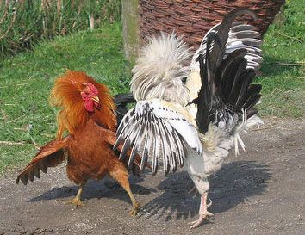
Dominance orders among animals
Dominance hierarchies:
  Observed across many species in the animal kingdom
  Including (most notably) among chickens
  You do not need a big brain to create a (complex) social network!
“Pure” dominance order:
  Directed
    A dominates B
  Anti-symmetric
    If A dominates B then B cannot dominate A

Slide 29
Dominance orders among animals
Dominance hierarchies:
  Observed across many species in the animal kingdom
  Including (most notably) among chickens
  You do not need a big brain to create a (complex) social network!
“Pure” dominance order:
  Complete (all ties present)
    Either A dominates B or B dominates A

Slide 30
Dominance orders among animals
Dominance hierarchies:
  Observed across many species in the animal kingdom
  Including (most notably) among chickens
  You do not need a big brain to create a (complex) social network!
“Pure” dominance order:
  Transitive (all ties present)
    If A dominates B, and B dominates C, then by necessity A dominates C

Slide 31
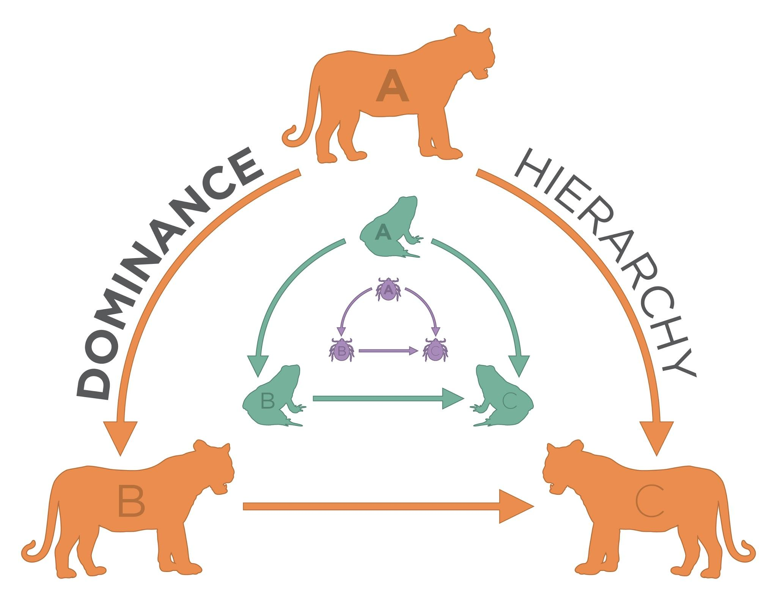
Algebraic Requirements for Dominance Order
A linear dominance order is transitive
Transitivity is a relation between node triples
  If a dominates b, and b dominates c
    Then a necessarily dominates c
a
b
c
This arc has to exist!
Transitive Triad

Slide 32
Algebraic Requirements for Dominance Order
A linear dominance order contains no cycles
  Flashback: A cycle is a path that begins and ends with the same node
a
b
c
This would be weird!
Cyclical Triad

Slide 33
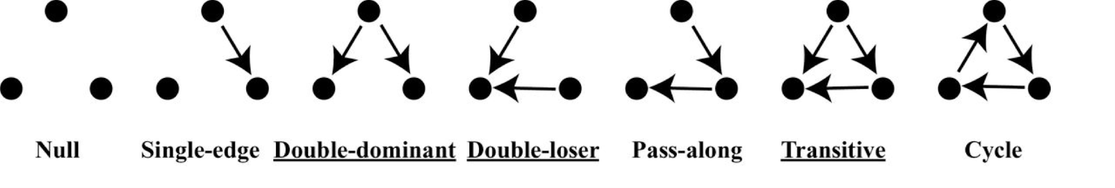
The emergence of dominance hierarchies
A dominance order can be represented as dominance network
  Nodes are animals (whether human or not)
  Directed, antisymmetric links indicate that animal i dominates animal j
Types of possible triads in dominance networks:

Slide 34
The emergence of dominance hierarchies
A dominance order can be represented as dominance network
  Nodes are animals (whether human or not)
  Directed, antisymmetric links indicate that animal i dominates animal j
Types of expected triads in dominance networks:

Slide 35
The emergence of dominance hierarchies
Chickens form perfectly linear hierarchies
  breaks down at about N=10
How are these social structures formed?
  An attribute based-model says position in the hierarchy is a function of individual characteristics (size, age, strength, etc.)
How do we
go from:
This
To this?

Slide 36
The emergence of dominance hierarchies
Chickens form perfectly linear hierarchies
  Breaks down at about N=10
How are these social structures formed?
  A interaction-based model says the hierarchy emerges from local network processes partially independently from attributes
How do we
go from:
This
To this?

Slide 37
Agonistic Competition as Iterative and Social
Three possible mechanisms:
  Winner Effects
    Confidence, testosterone boost, experience
    Emergence of double-dominant triads
  Loser Effects
    Lowered confidence, injury
    Emergence of double-loser triads
  Bystander Effects
    Confidence vis-à-vis winner and loser changes
    From single-edge to either:
      Double-dominant triads
Winner Effects
Loser Effects
Bystander Effects
Time 1
Time 2

Slide 38
Agonistic Competition as Iterative and Social
Three possible mechanisms:
  Winner Effects
    Confidence, testosterone boost, experience
    Emergence of double-dominant triads
  Loser Effects
    Lowered confidence, injury
    Emergence of double-loser triads
  Bystander Effects
    Confidence vis-a-vis winner and loser changes
    From single-edge to either:
      Double-loser triads
Winner Effects
Loser Effects
Bystander Effects
Time 1
Time 2

Slide 39
Agonistic Competition as Iterative and Social
Three possible mechanisms:
  Winner Effects
    Confidence, testosterone boost, experience
    Emergence of double-dominant triads
  Loser Effects
    Lowered confidence, injury
    Emergence of double-loser triads
  Bystander Effects
    Bystanders almost never dominate initial dominant
Winner Effects
Loser Effects
Bystander Effects
Weird!
Time 1
Time 2

Slide 40
Agonistic Competition as Iterative and Social
Three possible mechanisms:
  Winner Effects
    Confidence, testosterone boost, experience
    Emergence of double-dominant triads
  Loser Effects
    Lowered confidence, injury
    Emergence of double-loser triads
  Bystander Effects
    Bystanders almost never dominate initial dominant
    Bystanders almost never get dominated by initial loser
Winner Effects
Loser Effects
Bystander Effects
Also
Weird!
Time 1
Time 2

Slide 41
Agonistic Competition as Iterative and Social
Three possible mechanisms:
  Winner Effects
    Confidence, testosterone boost, experience
    Emergence of double-dominant triads
  Loser Effects
    Lowered confidence, injury
    Emergence of double-loser triads
  Bystander Effects
    Bystanders almost never dominate initial dominant
    Bystanders almost never get dominated by initial loser
    This guarantees transitivity and linearity!
Winner Effects
Loser Effects
Bystander Effects
Time 1
Time 2

Slide 42
Tendencies in Negative Tie Networks

Slide 43
Network Tendencies in Negative Tie Networks
Time 1
Time 2
Most of the tendencies discussed previously exist in negative tie networks
  E.g., homicides between gangs, bullying, etc.

Slide 44
Network Tendencies in Negative Tie Networks
Time 1
Time 2
Most of the tendencies discussed previously exist in negative tie networks
  E.g., homicides between gangs, bullying, etc.
Reciprocity
  People are likely to direct negative ties to those they receive them from
Reciprocity

Slide 45
Network Tendencies in Negative Tie Networks
Time 1
Time 2
Most of the tendencies discussed previously exist in negative tie networks
  E.g., homicides between gangs, bullying, etc.
Reciprocity
  People are likely to direct negative ties to those they receive them from
Homophily
  Negative ties are more likely to be shared by people who belong to the same group
Reciprocity
Homophily

Slide 46
Network Tendencies in Negative Tie Networks
Time 1
Time 2
Most of the tendencies discussed previously exist in negative tie networks
  E.g., homicides between gangs, bullying, etc.
Reciprocity
  People are likely to direct negative ties to those they receive them from
Homophily
  Negative ties are more likely to be shared by people who belong to the same group
Diffusion
  Recipients of negative ties tend to direct them at others
Reciprocity
Homophily
Diffusion

Slide 47
Network Tendencies in Negative Tie Networks
Time 1
Time 2
Most of the tendencies discussed previously exist in negative tie networks
  E.g., homicides between gangs, bullying, etc.
Reciprocity
  People are likely to direct negative ties to those they receive them from
Homophily
  Negative ties are more likely to be shared by people who belong to the same group
Diffusion
  Recipients of negative ties tend to direct them at others
Reciprocity
Homophily
Diffusion

Slide 48
Network Tendencies in Negative Tie Networks
Time 1
Time 2
But not all the tendencies that exist in positive tie networks exist in negative networks!
  In positive tie networks we see transitivity
    Friends of friends are friends
Transitivity

Slide 49
Network Tendencies in Negative Tie Networks
Time 1
Time 2
But not all the tendencies that exist in positive tie networks exist in negative networks!
  In positive tie networks we see transitivity
    Friends of friends are friends
  In negative tie networks we see less of a tendency to transitivity
    Enemies of enemies are not likely to be enemies
    If balance applies they are a friend!
  While positive ties tend to spread in networks negative ties don’t
Transitivity
No Transitivity

Slide 50
Network Tendencies in Negative Tie Networks
Time 1
Time 2
But not all the tendencies that exist in positive tie networks exist in negative networks!
  In positive tie networks we see transitivity
    Friends of friends are friends
  In negative tie networks we see less of a tendency to transitivity
    Enemies of enemies are not likely to be enemies
    If balance applies they are a friend!
  While positive ties tend to spread in networks negative ties don’t
Transitivity
No Transitivity

Slide 51
Network Tendencies in Negative Tie Networks
Centrality measures have different interpretations in negative tie networks
  The more degree centrality in terms of negative ties the less central you are
Outdegree you hate everyone else
Indegree everyone else hates you
  Bad in either case!
Good!
Bad!
Outdegree
Indegree

Slide 52
Network Tendencies in Negative Tie Networks
Centrality measures have different interpretations in negative tie networks
  Path based centrality measures don’t have an intuitive interpretation in negative ties networks
  Based on idea that things (advice, information, exchanges, favors) flow via positive ties
  So makes sense to reach or be a mediator
But nothing flows via negative ties!
Good!
??
Closeness
Good!
??
Betweenness

Slide 53
Papachristos’ (2009) Gang Violence Study

Slide 54
Violence Never Solves Anything, Except Agonistic Encounters
Obvious explanation: Gangs fight over drug routes
Structural explanation: Status competition between local groups
Recap of Papachristos 2009

Slide 55
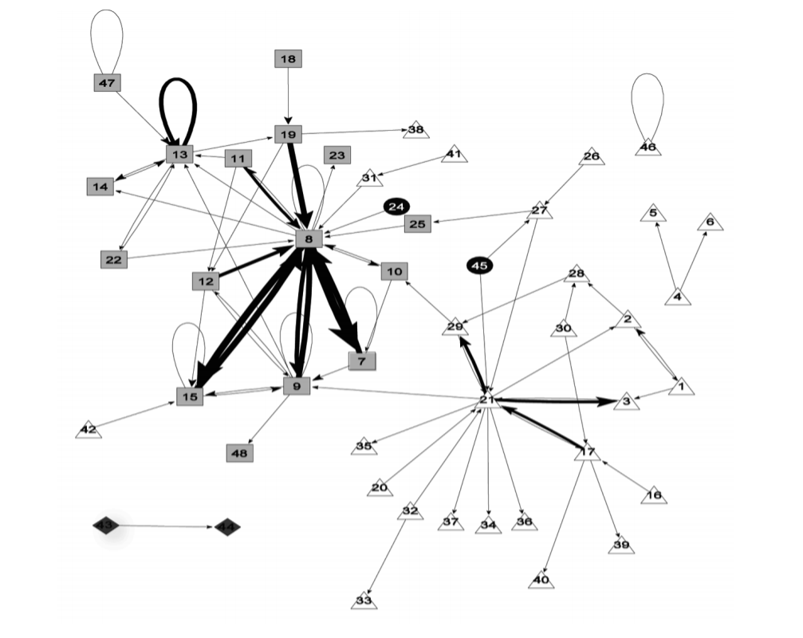
Black
Racial Homophily
Number of Nodes: 48
Density: 0.07
Reciprocal dyads: 36
Self-loops
Hispanic
Asian
White
The social structure of gang homicide in Chicago, 1994
Papachristos 2009

Slide 56
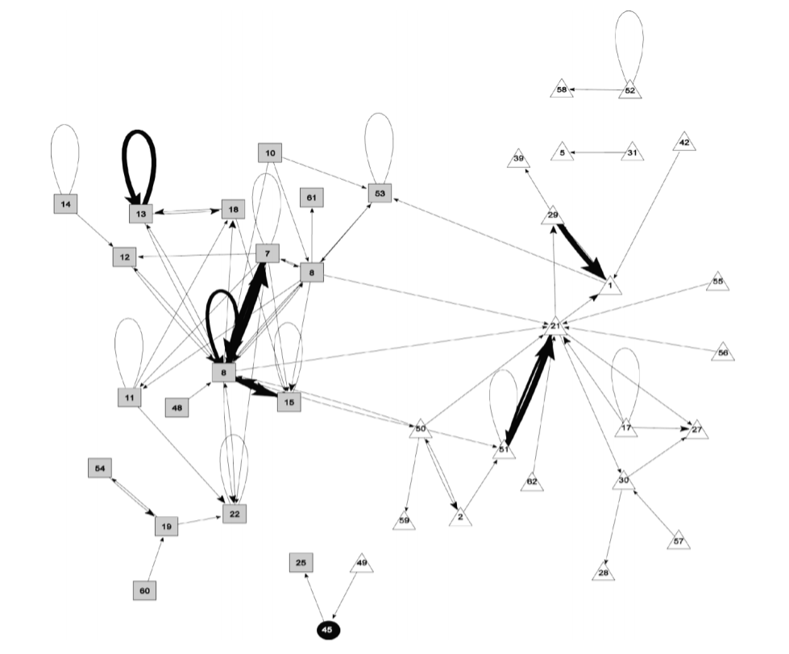
Black
Hispanic
Asian
White
The social structure of gang homicide in Chicago, 1998
Papachristos 2009

Slide 57
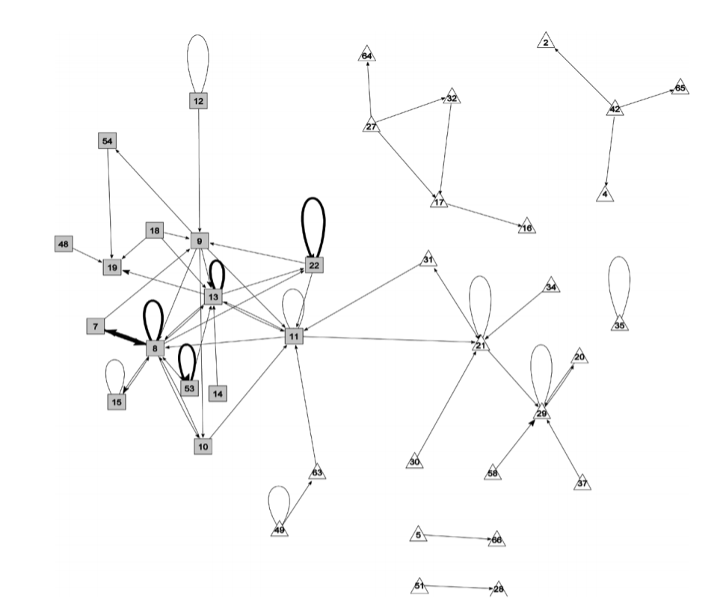
Black
Hispanic
Asian
White
The social structure of gang homicide in Chicago, 2002
Papachristos 2009

Slide 58
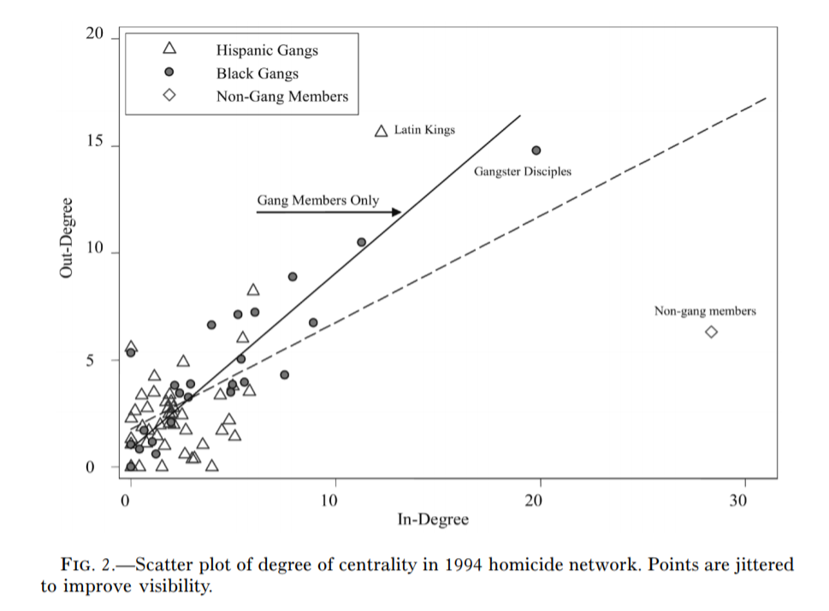
Black
Hispanic
Asian
White
The social structure of gang homicide in Chicago, 1994
Papachristos 2009

Slide 59
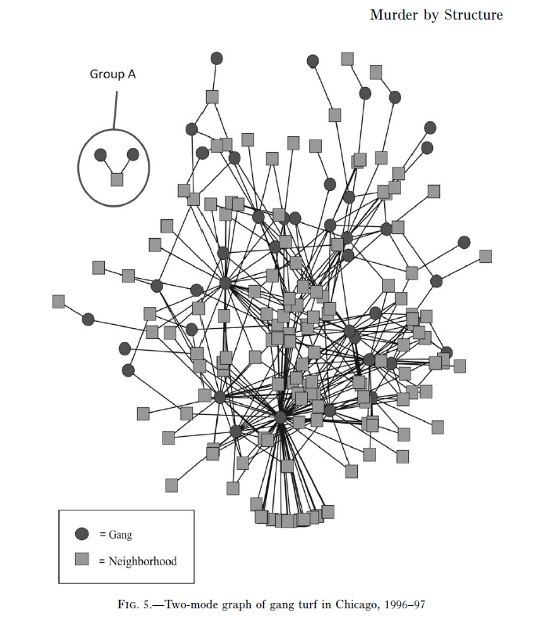
Papachristos 2009

Slide 60
When does violence occur?
Average overlap between 2 gangs: 10%
Overlap that results in murder: 25%+
Every 1% increase doubles the probability of a murder increasing
Not unusual, peace
Very bad things happen

Slide 61
When does violence occur?
Papachristos argues we can think of murder as a network phenomenon
Crime is not some individual in isolation responding to a set of deprivations, but inherently a social phenomena
Not unusual, peace
Very bad things happen

Slide 62
Two ways violence spreads
Murder
Murder
Gang 1
Gang 2
Gang 1
Gang 2
Payback
Gang 3
Gang 3
Time 1
Time 2
Direct Retaliation (Reciprocity)

Slide 63
Two ways violence spreads
Murder
Murder
Gang 1
Gang 2
Gang 1
Gang 2
Gang 3
Gang 3
Show of force
Time 1
Time 2
Generalized Violence (Diffusion)

